Slide 1
Cybersecurity
Principles of Social Engineering

Slide 2
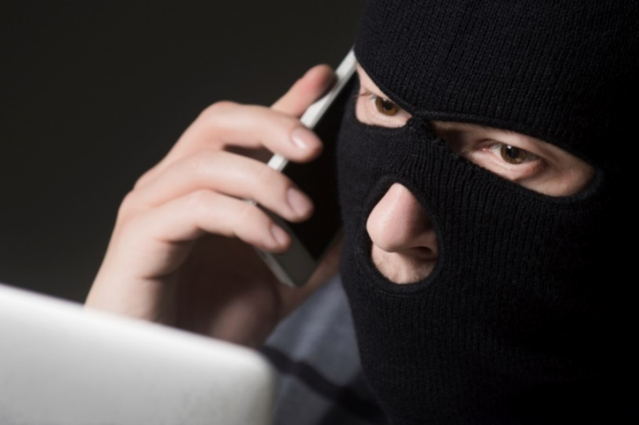
Effective Social Engineering
Manipulating social interactions to gain access or privileged information
May be a team working together
Could be done face-to-face or online
“Customers” calling
“Suppliers” calling
Third party repair service (cable, elevator, fire inspection)

Slide 3
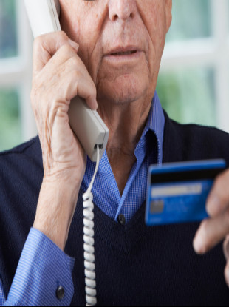
Social Engineering Principles
Authority
The attacker is in charge
“Don’t you know who I am?!”
“This is the police!”
Intimidation
Repercussions if you do not comply
If you don’t help, bad things happen.
Consensus/Social proof
Make it seem routine
“This isn’t the first time we’ve done this.”
“Jose in IT did this for me last time.”

Slide 4
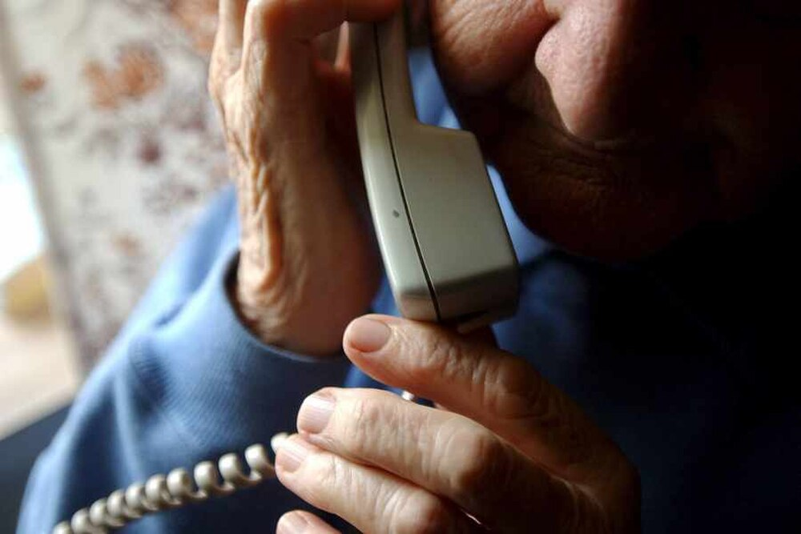
Social Engineering Principles
Scarcity
Limited time to decide
Limited opportunity
Urgency
Gotta act now
No time to think
Familiarity/Liking
Someone you know, we have common friends
“John put me in touch with you”
Trust
Someone who is safe
“I’m from IT. I’m being helpful. Let me help you.”

Slide 5
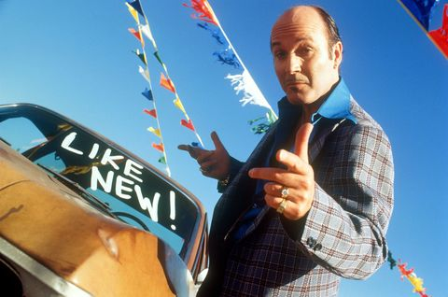
Defending against Social Engineering
Be on the lookout for these red flags/warning signs:
Authority
Intimidation
Scarcity
Urgency
Familiarity
Trust
Notice these in sales tactics too
“Call now!” (urgency)
“Supplies are limited!” (scarcity)
“9 out of 10 agree…” (authority/trust)

Slide 6
How I Lost My $50,000 Twitter Username
Naoki Hiroshima - @N
www.medium.com/cyber-security/24eb09e026dd
Bad guy calls PayPal and uses social engineering to get the last four digits of the credit card on file
Bad guy calls GoDaddy and tells them he lost the card, so he can’t properly validate. He has the last four, does that help?
GoDaddy let the bad guy guess the first two digits of the card
He was allowed to keep guessing until he got it right
Social engineering done really, really well

Slide 7
How to Steal a $50,000 Twitter Name
Bad guy is now in control of every domain name
And there were some good ones
Bad guy extorts a swap
Domain control for @N
Owner agrees
Twitter reviewed the case for a month
Eventually restored access to @N
How I lost my $50,000 Twitter Username
www.medium.com/cyber-security/24eb09e026dd

